Slide 1
AWS: A Cloud Comparison
Brian Korzynski

Slide 2

About Me
Principal Architect
Professional Developer for 14+ years
Windows Forms
Web
Mobile
SQL Optimization
Data Analysis
Mathematics
Big Data
Cloud
Machine Learning
IRON MOUNTAIN

Slide 3
Disclaimer
We will only focus on the mostly used cloud offerings, and how they compare
This will only be an overview of the different offerings, but there will be links to the services if you would like more info
I will be sharing my experiences using the different offerings in all three cloud providers (Azure, AWS, and GCP)
We won’t discuss pricing much, since the offerings are very similarly priced and can vary wildly depending on your needs.

Slide 4
Polls
Who has used other cloud providers (outside AWS)?
What programming languages are you working in?
What kinds of applications/architectures are you currently doing in AWS?

Slide 5
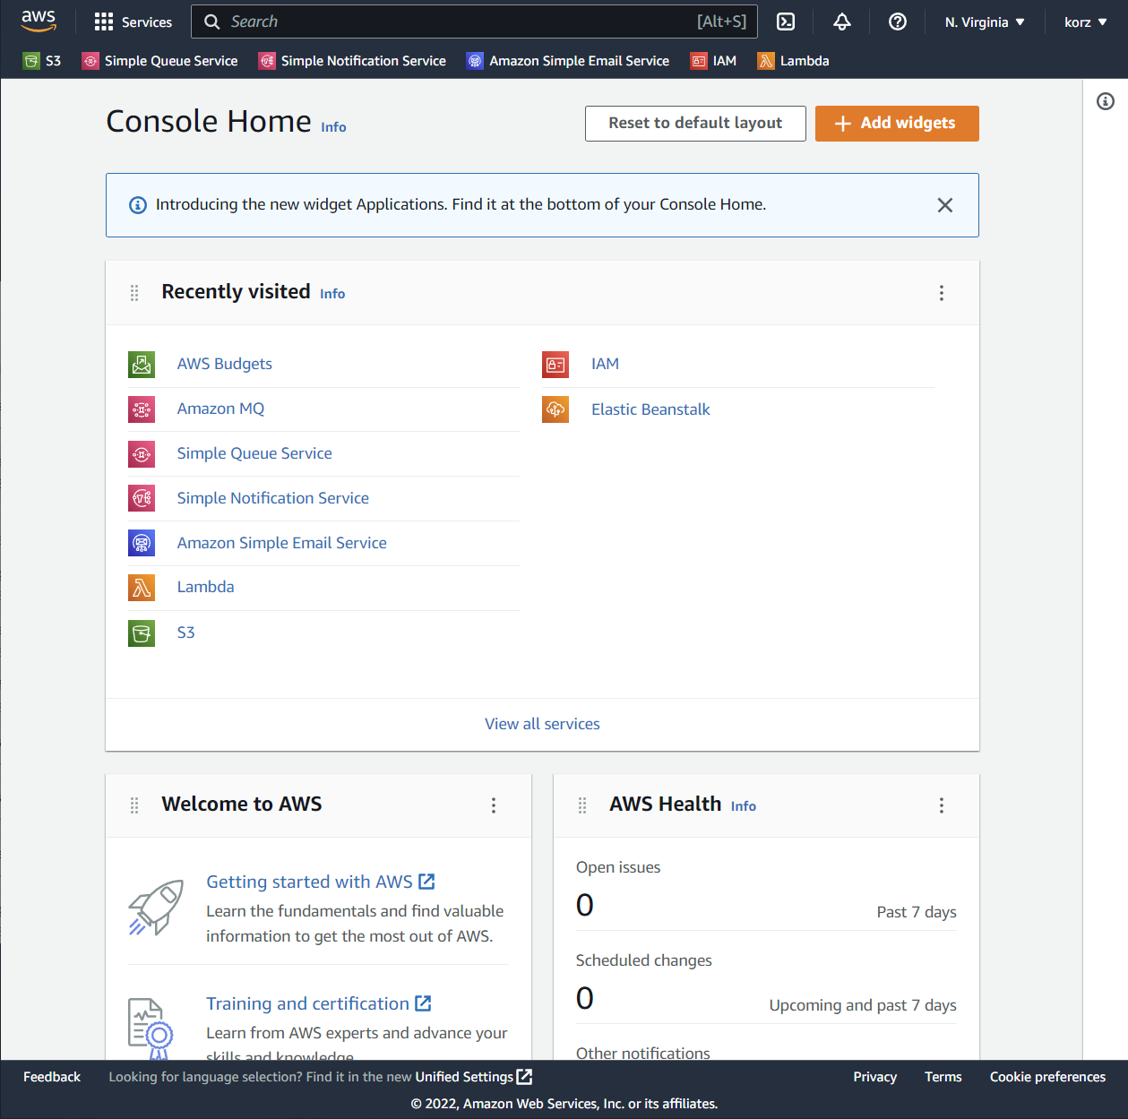
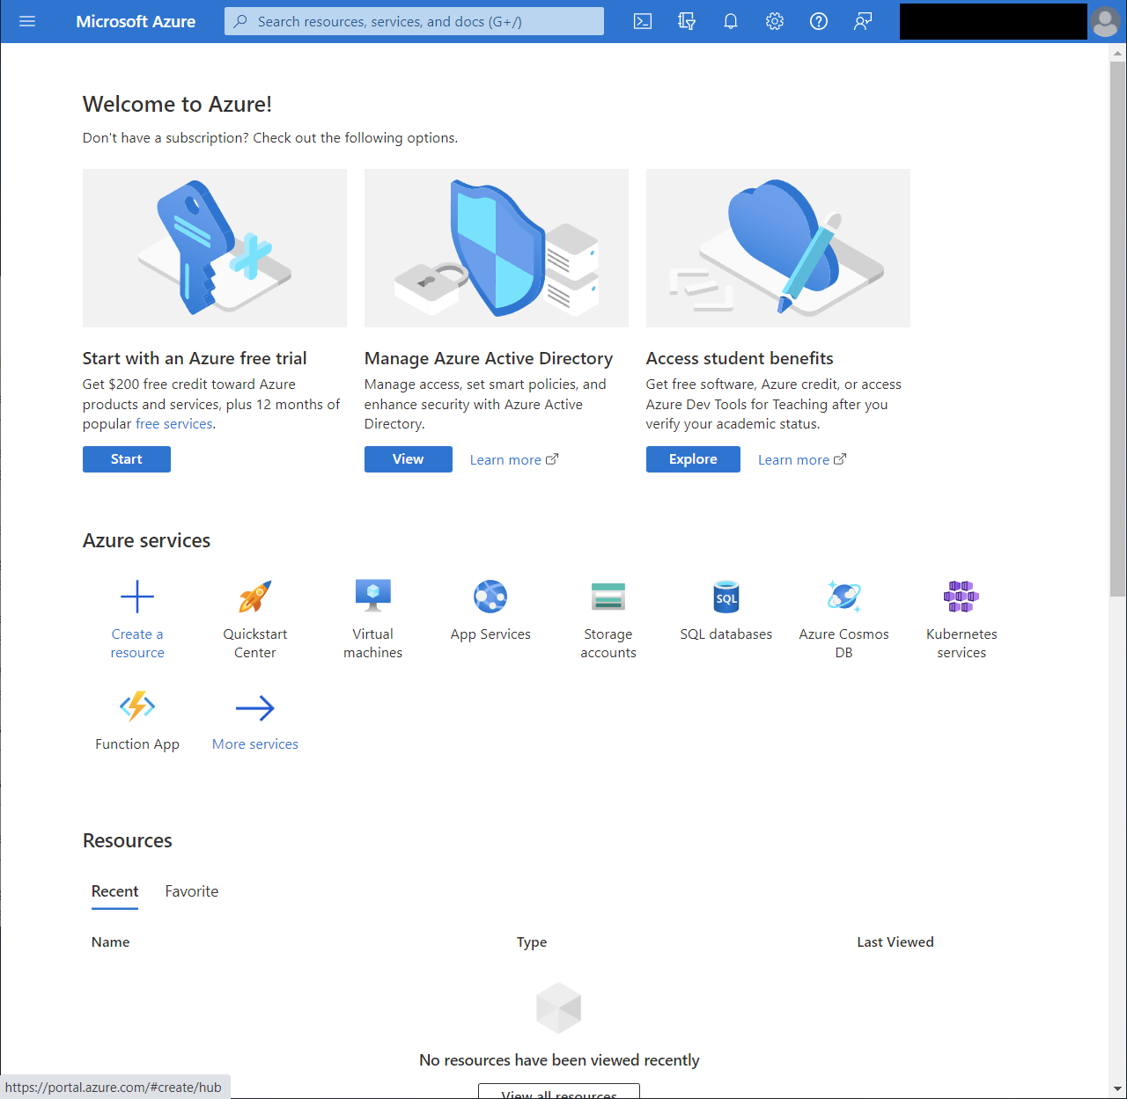
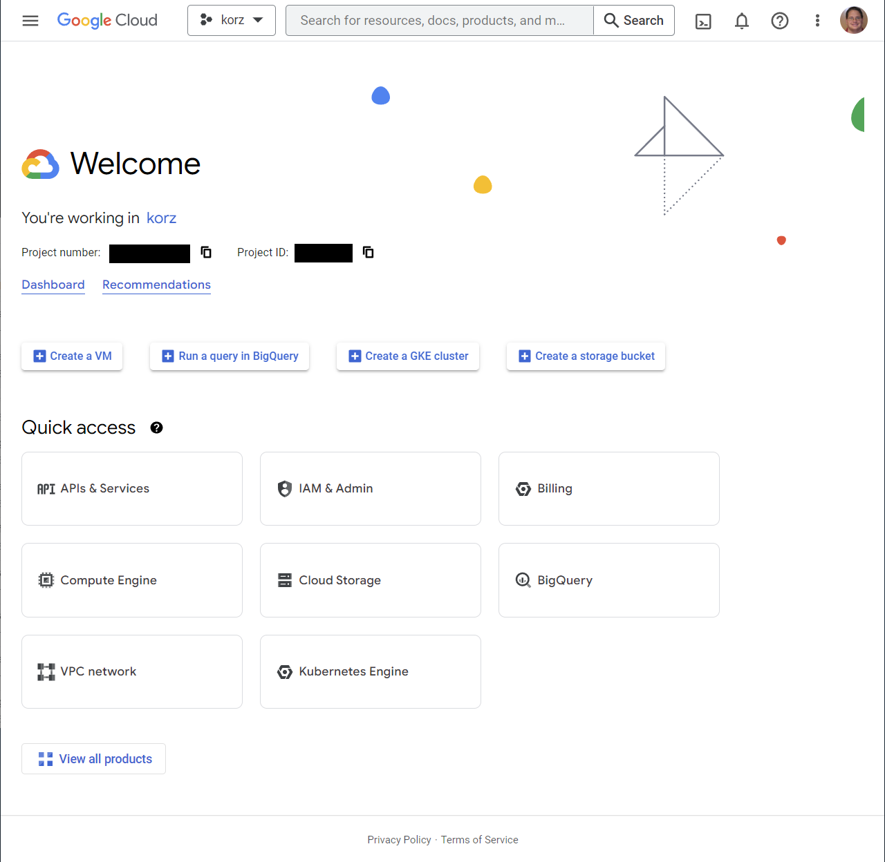
Consoles
Amazon Web Services
(AWS)
Microsoft Azure
(Azure)
Google Cloud Platform
(GCP)
Portal
https://portal.azure.com/
Console
https://console.cloud.google.com/
Console
https://aws.amazon.com/console/

Slide 6
Command Line Interfaces (CLI’s)
AWS
Linux
GCP
Typically follows the Linux Commands
We specify the service we want to work with (e.g. aws s3)
File paths are start with s3:// for easy access to files, without the need to browse in the console
More Info: https://docs.aws.amazon.com/cli/latest/reference/index.html#cli-aws
This is the command we would use in Linux to copy a file
Typically follows the Linux Commands
File paths are start with gs:// for easy access to files, without the need to browse in the console
Notice how we don’t the GCS service here
The –m flag denotes that we want to run multi-threaded
More Info: https://cloud.google.com/storage/docs/gsutil/commands
Note: both AWS and GCP are using an authenticated CLI so no need to pass in credentials

Slide 7
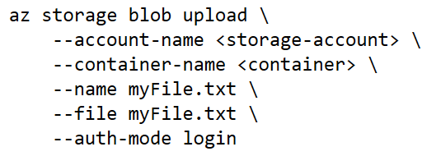
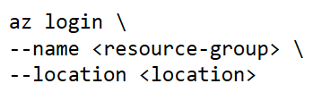
Command Line Interfaces (CLI’s)
Azure
Automatically Authenticate Commands
Notice how the command looks nothing like the other two
We must specify some additional details since Azure works doesn’t have a direct file storage like AWS and GCP do (more on this later)
Commands are Powershell Commandlets, instead of being like Linux like the other two are
This will prompt you to login upon running
You can login so commands are automatically authenticated using the az login command
More Info: https://learn.microsoft.com/en-us/cli/azure/storage/blob?view=azure-cli-latest
Quickstart: https://learn.microsoft.com/en-us/azure/storage/blobs/storage-quickstart-blobs-cli

Slide 8
Software Developer Kits (SDK’s)
Allow you to programmatically control cloud services and assets. For example, if you wanted to create a new S3 bucket or pull a message from an SQS queue.
Eases the interaction between your application and the cloud service, because we don’t have to make a ton of REST/HTTP calls and ensure that we get the headers and content just right.
Provides a good abstraction/interface to the service in case things change, such as endpoints, or request/response objects.
You want to use the SDK’s and CLI’s (as opposed to making the HTTP call yourself) wherever possible. This is especially true in Azure, since in the past they have drastically changed endpoints without warning, breaking applications.

Slide 9
Software Developer Kits (SDK’s)
AWS
Azure
GCP
Comprehensive Service Coverage
Available in C++, C#, Java, JavaScript, and Python
More Info: https://aws.amazon.com/developer/tools/
Comprehensive Service Coverage
Available in C++, C#, Java, JavaScript, and Python
More Info: https://azure.github.io/azure-sdk/releases/latest/index.html
Comprehensive Service Coverage
Available in C#, Java, and Python
More Info: https://cloud.google.com/translate/docs/advanced/discovering-supported-languages-v3#translate_v3_get_supported_languages-additional-langs

Slide 10
Continuous Integration
AWS CodeBuild
Azure DevOps
GCP
Managed Build Server
More Info: https://aws.amazon.com/codebuild/
Full development and DevOps environment.
Most comprehensive of the Bunch
Some Features Include:
Managed Build Server
Source Code Repositories
Agile Story Tracking
CI/CD Pipelines
Test Plans
CI/CD Artifact Hosing
Online IDE for quick changes
Marketplace of additional functionality
More Info: https://azure.microsoft.com/en-us/products/devops/
There is no known dedicated service for building applications. However, if you want to build and deploy containerized apps you can use Cloud Run (more on this later)

Slide 11
Continuous Delivery
AWS CodeDeploy
Azure DevOps
Google Cloud Deploy
Automates code deployment to maintain application uptime
More Info: https://aws.amazon.com/codedeploy/
Everything the CodeDeploy does and then some
CI/CD Pipelines allow for the ultimate flexibility when building and deploying applications
All the other awesomeness we already talked about
Pretty much the same thing as AWS CodeDeploy, I haven’t found any noteworthy differences
Works on both GCP (cloud) and Anthos (on-prem)
More Info: https://cloud.google.com/deploy

Slide 12
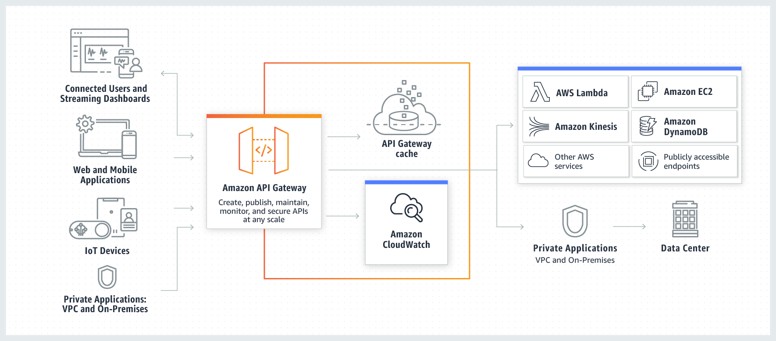
API Management
Fully managed services that makes it easy for developers to create, publish, maintain, monitor, and secure APIs at any scale.

Slide 13
API Management
All the cloud offerings seem to be about the same but may differ slightly in features
AWS API Gateway
https://aws.amazon.com/api-gateway/
Azure API Management
https://azure.microsoft.com/en-us/products/api-management/
GCP API Gateway
https://cloud.google.com/api-gateway

Slide 14
Virtual Machines (VM)
AWS EC2
(Elastic Compute Cloud)
Azure Virtual Machines
Google Compute Engine
Secure and resizable compute capacity
Works with Windows or Linux VM’s
Supports On-Demand, Spot, and Dedicated instances
Offers many different VM sizes (CPU, Memory, Disk)
More Info: https://aws.amazon.com/ec2/
Pretty much the same exact thing as EC2
More Info: https://azure.microsoft.com/en-us/products/virtual-machines/
Pretty much the same exact thing as EC2
Coolest name of the bunch
More Info: https://cloud.google.com/compute
Note: You should prefer PaaS to IaaS

Slide 15
Web Application Hosting
AWS Elastic Beanstalk
Azure Static Web Apps
GCP App Engine
Deploy and scale web applications
Meant for your non-containerized web apps
More Info: https://aws.amazon.com/elasticbeanstalk/
Pretty much the same exact thing as Elastic Beanstalk
Has streamlined improvements for static (non-changing) applications
More Info: https://azure.microsoft.com/en-us/products/app-service/static/#overview
Seems to pretty much the same exact thing as Elastic Beanstalk, but I don’t have a ton of experience with this service, so not sure of differences
More Info: https://cloud.google.com/appengine

Slide 16
Web API/Service Hosting
AWS App Runner
Azure App Service
GCP Cloud Run
Deploy containerized web applications and API’s (web services)
Unlike Elastic Beanstalk, it’s meant for your containerized apps, although it also works from code
More Info: https://aws.amazon.com/apprunner/
Allows hosting of both web applications and API’s, serving the role of both Elastic Beanstalk and App Runner
Works with containerized and non-containerized apps
Scaling works really good and you have complete control over it
Works great with Docker Images or GitHub Actions (automatically build, version, and deploy upon check in) thus eliminating the need for CloudBuild and CloudDeploy
App settings (config) has a much nicer interface
More Info: https://azure.microsoft.com/en-us/products/app-service/#features
Pretty much the same exact thing as App Runner, except:
that it also acts as a development and build platform
Apps must be containerized
More Info: https://cloud.google.com/run

Slide 17
Serverless Functions
AWS Lambda
Azure Functions
GCP Cloud Functions
Serverless and Container-less Compute
Allows control over other AWS products such as S3 files or Kinesis streams
Works with containerized images (code smell)
Many invocation triggers:
Manual Invocation (Console, CLI, or SDK, or HTTP)
Service Events from SQS or SNS
HTTP
Can run synchronously (wait for execution to finish before starting next request), or asynchronously (run multiple instances at the same time).
More Info: https://aws.amazon.com/lambda/
Pretty much the same exact thing as Lambda except:
More straightforward setup of function, configuration, and triggers.
More comprehensive trigger options out of the box, for example you automatically get HTTP endpoint and CRON trigger (schedule runs without the need for secondary service)
Better development experience. You can develop and debug locally using Visual Studio Code
More Info: https://azure.microsoft.com/en-us/products/functions/#overview
Pretty much the same exact thing as Lambda except:
Not as comprehensive support over other GCP services, like AWS and Azure
Limited set of triggers (HTTP, GCS Events, and Pub/Sub Events)
Running on a schedule, means you must create a Cloud Scheduler job that writes to a Pub/Sub queue on a time interval, then set the Pub/Sub trigger for the function to execute
Supports a smaller list of languages (only C#, Java, Javascript, and Python)
Only supports asynchronous run
More Info: https://cloud.google.com/functions
Note: functions are meant for small pieces of code with quick execution times. Not an app replacement.

Slide 18
Docker
Amazon ECR
(Elastic Container Registry)
Azure Container Registry
GCP Container Registry
Easily store share, and deploy your Docker containers
You can use GitHub Actions to build, version, and deploy to container registry upon code check-in. An easy way to do nightly builds
More Info: https://aws.amazon.com/ecr/
Pretty much the same thing as ECR
More Info: https://azure.microsoft.com/en-us/products/container-registry/#overview
Pretty much the same thing as ECR
More Info: https://cloud.google.com/container-registry

Slide 19
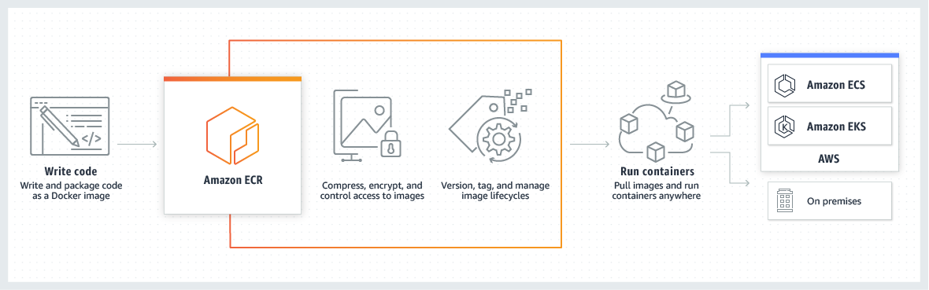
How Docker Container Works

Slide 20
Kubernetes
AWS EKS
(Elastic Kubernetes Service)
Azure Kubernetes Service
GKE
(Google Kubernetes Engine)
Managed Kubernetes engine
Kubernetes, also known as K8s, is an open-source system for automating deployment, scaling, and management of containerized applications. (https://kubernetes.io/)
More Info: https://aws.amazon.com/eks/
Pretty much the same as EKS
More Info: https://azure.microsoft.com/en-us/products/kubernetes-service/#overview
Pretty much the same as EKS
More Info: https://cloud.google.com/kubernetes-engine
Note: For the features I use daily I don’t notice a difference between them. For more comprehensive comparison check out
https://acloudguru.com/blog/engineering/aks-vs-eks-vs-gke-managed-kubernetes-services-compared

Slide 21
File Storage
AWS S3
(Simple Storage Service)
Azure Blob Storage
GCS
(Google Cloud Storage)
Object Storage Service with scalability, data availability, security, and performance built-in
Bucket names must be globally unique
Folders are first class citizens, so it acts like more of a true File System
Uses the bucket, folder, file layout
Unlimited size buckets (file count and size)
Can store blobs in addition to files
Files get unique name denoting path like file system but prefixed with s3:// instead of c:/
s3://bucket_name/some_path/to_file/filename.txt
More Info: https://aws.amazon.com/s3/
Object Storage Service with scalability, data availability, security, and performance built-in
Bucket names must be globally unique
Folders are first class citizens, so it acts like more of a true File System
Uses the container, folder, file layout
5PB storage account limit, no blob count limit
Older but much lower cost option than Azure Files
Can store blobs in addition to files
Files get unique URL’s instead of paths e.g. https://korztest.blob.core.windows.net/blobtest/myFiles/moreFiles/myFile.txt
More Info: https://azure.microsoft.com/en-us/products/storage/blobs/
Object Storage Service with scalability, data availability, security, and performance built-in
No real concept of a folder, so if a folder is emptied it is deleted
Uses blob layout where anything within a bucket is a blob, so folders would just be a blob with blobs
Unlimited size buckets (file count and size)
Not sure if it can store blobs in addition to files
Files get unique name denoting path like file system but prefixed with gs3:// instead of c:/
gs://bucket_name/some_path/to_file/filename.txt
More Info: https://cloud.google.com/storage
Notes:
Azure Files is basically a cloud version of a network share

Slide 22
Traditional Relational Databases
AWS RDS
(Relational Database Service)
Azure Database
GCP Cloud SQL
Fully managed relational database for MySQL, MariaDB, PostgreSQL, Oracle, and SQL Server.
More Info: https://aws.amazon.com/rds/
Different Product depending on database platform
Azure SQL Database (SQL Server)
Azure Database for MySQL
Azure Database for Postgres
etc.
Each offering is pretty much the same as RDS
More Info: https://azure.microsoft.com/en-us/products/mysql/
Pretty much same as RDS, but only for MySQL, PostgreSQL, and SQL Server
More Info: https://cloud.google.com/sql

Slide 23
Serverless Relational Databases
AWS Aurora
Azure Cosmos DB
GCP Cloud Spanner
RDBMS built for the cloud with full MySQL and PostgreSQL compatibility
Designed for unparalleled high performance and availability at global scale
More Info: https://aws.amazon.com/rds/aurora/
Fully managed relational and NoSQL database
Multi-modal NoSQL design supporting Key/Value Pair, Document, Graph, and column designs
Designed for unparalleled high performance and availability at global scale
More Info: https://azure.microsoft.com/en-us/products/cosmos-db/
Pretty much same as Aurora, but only for PostgreSQL
More Info: https://cloud.google.com/spanner

Slide 24
Document Databases (NoSQL)
AWS DocumentDB
Azure Cosmos DB
GCP Firestore
Fully managed JSON based document database with easy enterprise workload scaling
More Info: https://aws.amazon.com/documentdb/
Fully managed relational and NoSQL database
Multi-modal NoSQL design supporting Key/Value Pair, Document, Graph, and column designs
Designed for unparalleled high performance and availability at global scale
More Info: https://azure.microsoft.com/en-us/products/cosmos-db/
Pretty much same as DocumentDB
More Info: https://cloud.google.com/firestore
Note: these are non-Mongo offerings of Document databases

Slide 25
Key/Value Pair Databases (NoSQL)
AWS DynamoDB
Azure Cosmos DB
GCP Bigtable
Fully managed, fast, flexible NoSQL Key/Value Pair database
More Info: https://aws.amazon.com/dynamodb/
Fully managed relational and NoSQL database
Multi-modal NoSQL design supporting Key/Value Pair, Document, Graph, and column designs
Designed for unparalleled high performance and availability at global scale
More Info: https://azure.microsoft.com/en-us/products/cosmos-db/
Pretty much same as DynamoDB
Has big focus on analytical workloads
More Info: https://cloud.google.com/bigtable
Note: this is the last of the NoSQL offerings since I don’t think people actually use graph or column

Slide 26
Redis Caches
Amazon ElastiCache for Redis
Azure Cache for Redis
GCP MemoryStore
Super-fast in-memory cache providing highly available, distributed, and secure data access with microsecond latency
More Info: https://aws.amazon.com/elasticache/redis
Pretty much the same as ElastiCache for Redis
More Info: https://azure.microsoft.com/en-us/products/cache/
Pretty much the same as ElastiCache for Redis
More Info: https://cloud.google.com/memorystore

Slide 27
Data Warehouses
AWS Redshift
Azure Cache for Redis
GCP BigQuery
Serverless Data Warehouse
More Info: https://aws.amazon.com/redshift/
Pretty much the same as Redshift
More Info: https://learn.microsoft.com/en-us/azure/architecture/aws-professional/services
Pretty much the same as Redshift
More Info: https://cloud.google.com/bigquery

Slide 28
Queues
Amazon SQS
(Simple Queue Service)
Azure Service Bus
GCP Pub/Sub
Fully managed message queuing for microservice, distributed systems, and serverless applications
Standard Queues have unlimited throughput, at-least once delivery, and best-effort delivery
FIFO Queues have high throughput, exactly-once delivery, and first-in first-out delivery
Support for dead letter queues
Supported Queue Types are work queues, fanout, and priority
More Info: https://aws.amazon.com/sqs/
Pretty much the same as SQS
More Info: https://azure.microsoft.com/en-us/products/service-bus/
Very simple message queueing using only the Pub/Sub pattern, and hence its name
It can also stream data like Kafka
Has at-least-once delivery, exactly-once processing, ability to seek and replay, dead letter topics, filtering/priority queueing
More Info: https://cloud.google.com/pubsub
Note: Azure Service Bus is my go-to, however there are times where you might want to use Storage Queues instead, check out this link for more info
https://learn.microsoft.com/en-us/azure/service-bus-messaging/service-bus-azure-and-service-bus-queues-compared-contrasted

Slide 29
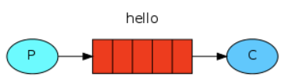
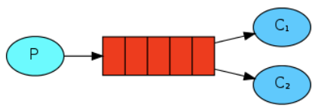
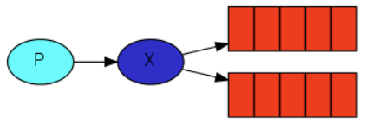
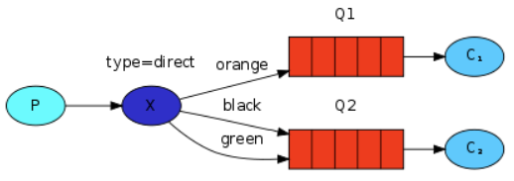
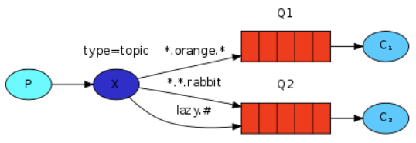
Queues Strategies
Publisher / Consumer
Worker Queues
Publisher/Subscriber
Routing/Binding
Topics

Slide 30
Streaming Queues (Kafka-like)
Amazon Kinesis Data Streams
Azure Event Hubs
Managed Apache Kafka for Google Cloud
Fully managed, serverless data streaming service that stores and ingest various streaming data in real time at any scale
Useful for real-time IoT, logging, or analytics
More Info: https://aws.amazon.com/kinesis/data-streams/
Pretty much the same as Kinesis Data Streams
More Info: https://azure.microsoft.com/en-us/products/event-hubs/
Like Kinesis, but is a cloud hosted version of Kafka
More Info: https://www.confluent.io/partner/google-cloud/

Slide 31
Storage Migration
AWS Snowball
Azure Data Box
GCP Transfer Appliance
High-capacity storage device that enables you to transfer and securely ship your data to AWS
More Info: https://aws.amazon.com/snowball/
Pretty much the same as Snowball
More Info: https://azure.microsoft.com/en-us/products/databox/
Pretty much the same as Snowball
More Info: https://cloud.google.com/transfer-appliance/docs/4.0/overview

Slide 32
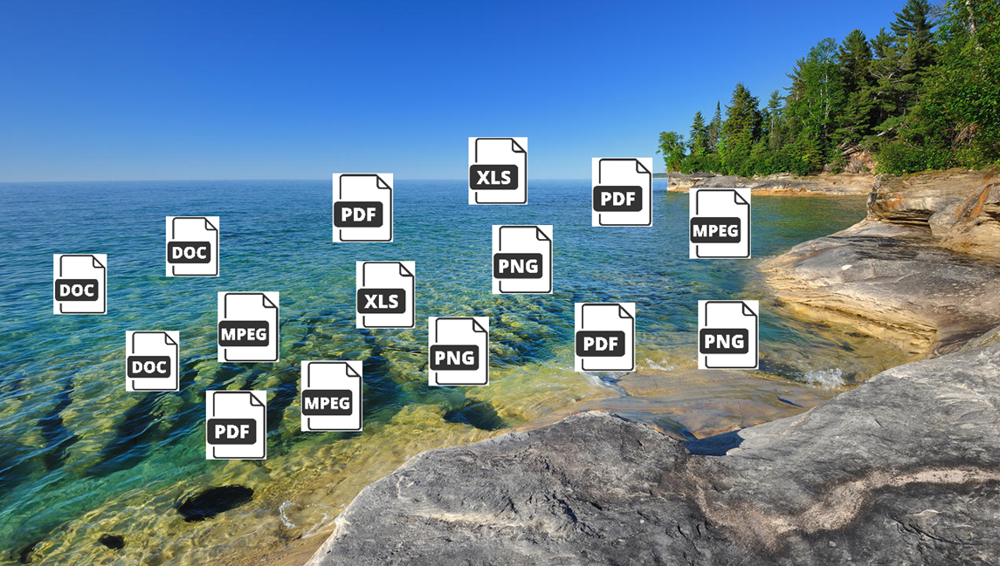
Data Lakes
“A data lake is a centralized repository designed to store, process, and secure large amounts of structured, semi-structured, and unstructured data.”
Actually, just S3, Blob Storage, or GCS
Azure does have a separate product called Azure Data Lake with more features
Useful Links:
https://azure.microsoft.com/en-us/solutions/data-lake/
https://aws.amazon.com/solutions/implementations/data-lake-solution/
https://cloud.google.com/learn/what-is-a-data-lake

Slide 33
Hadoop / Spark
AWS EMR
(Elastic MapReduce)
Azure HDInsight
GCP Data Proc
Host for Hadoop, Spark, and associated services such as YARN, HDFS, HBase, and Hive
Used for processing data concurrently distributed
Works well with S3 (don’t necessarily need HDFS)
Useful for real-time IoT, logging, or analytics
More Info: https://aws.amazon.com/emr
Pretty much the same as EMR
Adds support for R Server, Pig, ZooKeeper
Seems more mature than Data Proc
More Info: https://azure.microsoft.com/en-us/products/hdinsight
Pretty much the same as EMR
Scales very nicely
Easily integrates with PySpark
This is the platform I use everyday
More Info: https://cloud.google.com/dataproc
https://cloud.google.com/learn/what-is-hadoop
https://www.ibm.com/cloud/blog/hadoop-vs-spark

Slide 34
OCR
AWS Textract
Azure Computer Vision OCR
GCP Document AI
Machine Learning (ML) service that automatically extracts text, handwriting, and data from scanned documents
Very accurate, like orders of magnitude higher than Tesseract
More Info: https://aws.amazon.com/textract/
Pretty much the same as Textract
Speed and accuracy are about the same, but Textract is better with tables
More Info: https://azure.microsoft.com/en-us/products/cognitive-services/computer-vision
Pretty much the same as Textract
Speed and accuracy are about the same, but Textract is better with tables
Can return Key/Value Pairs
Is more than just OCR, it’s a platform, for example it can automatically extract invoices and receipts
More Info: https://cloud.google.com/document-ai

Slide 35
Notebooks
Amazon SageMaker Studio
Azure ML
GCP Vertex AI Workbench
Web-based, integrated development environment (IDE) that lets you prepare data, build, train, deploy, and monitor your machine learning models
More Info: https://aws.amazon.com/sagemaker/studio/
Can be a JupyterLab and Notebooks environment host
Can also host models (like SageMaker)
ML Studio allows for drag and drop data science (more in a second)
More Info: https://learn.microsoft.com/en-us/azure/machine-learning/how-to-run-jupyter-notebooks
Fully managed compute for Jupyter Notebooks using JupyterLab
This is the environment that I code in everyday
More Info: https://cloud.google.com/vertex-ai-workbench

Slide 36
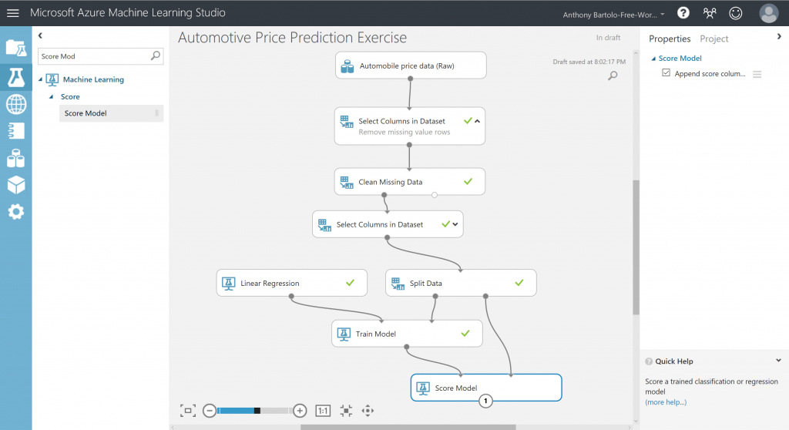
Azure ML Studio

Slide 37
MLaaS (ML as a Service) ML Model Hosting
Amazon SageMaker
Azure ML
GCP Vertex AI
Build, train, and deploy machine learning (ML) models for any use case with fully managed infrastructure, tools, and workflows
Just provide an ONNX version of the model and the code to call it, and it turns it into a PaaS-like service for prediction
More Info: https://aws.amazon.com/sagemaker/
As a model host it is exactly the same as SageMaker
More Info: https://azure.microsoft.com/en-us/products/machine-learning
As a model host it is exactly the same as SageMaker
More Info: https://cloud.google.com/vertex-ai

Slide 38
AutoML (Image Use Case)
Amazon SageMaker Autopilot
Azure Custom Vision API
GCP AutoML Image
Automatically create machine learning models with full visibility
Is a more generic solution than the Azure or GCP offerings
More Info: https://aws.amazon.com/sagemaker/autopilot
You create a custom vision model by uploading images and giving it a label, and it does the rest
By far the easiest of these services to work with
More Info: https://azure.microsoft.com/en-us/products/cognitive-services/custom-vision-service/
Similar in concept to Custom Vision API, only not as easy to use
It creates models that are accurate
Accuracy is the same as Custom Vision API and Autopilot
More Info: https://cloud.google.com/vertex-ai/docs/training-overview#image

Slide 39
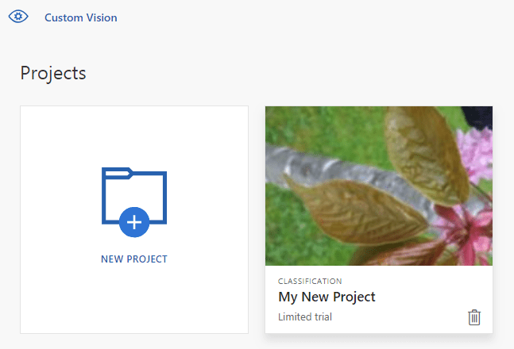
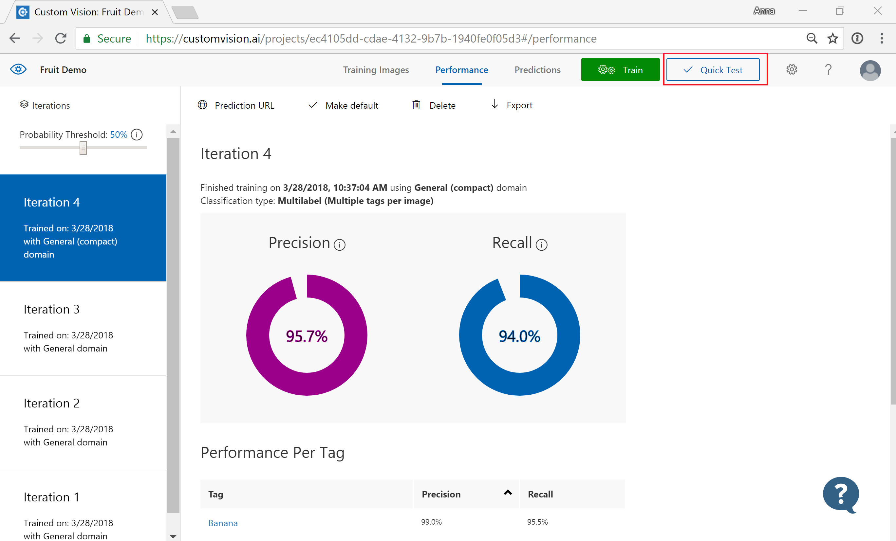
Azure Custom Vision API
Create Project and Upload Files
Review Model Accuracy

Slide 40
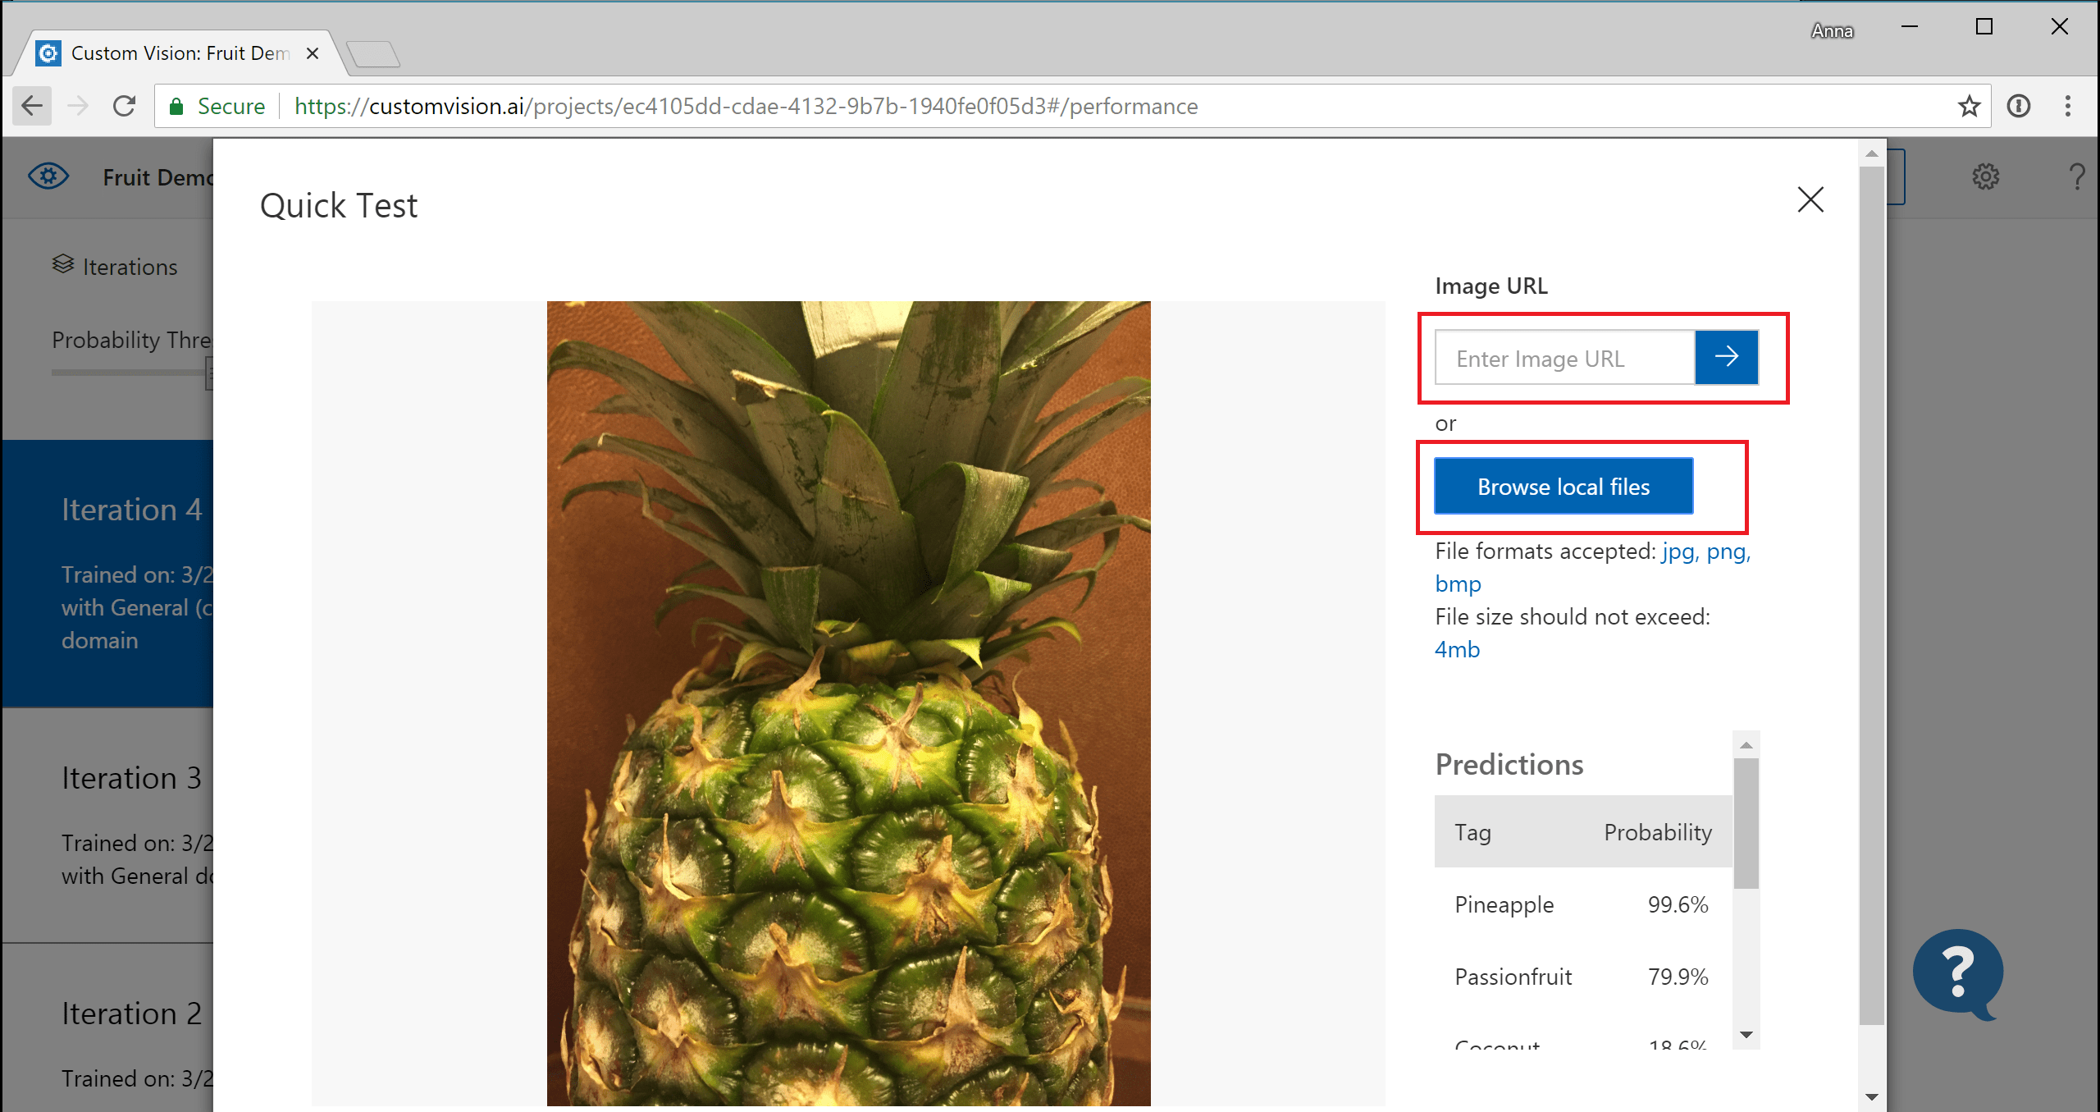
Azure Custom Vision API
Predict

Slide 41
Not Enough Time To Go Over
IoT Services (e.g. AWS IoT Core, Azure IoT Hub, GCP Cloud IoT)
Networking & IAM (Identity and Access Management)
On-Premises Clouds
AWS Outposts (https://aws.amazon.com/outposts/)
Azure Stack (https://azure.microsoft.com/en-us/products/azure-stack/)
Google Anthos (https://cloud.google.com/Anthos)
Entire cloud environments can be scripted using Terraform of Ansible (works for all)

Slide 42
Architecture Considerations
THERE ARE NONE
The offerings are similar enough, that you really don’t have to change your current cloud architectures, its now just use this service instead of that one
However, there might be new services you want to utilize, which could improve your workflow and make your architecture more solid

Slide 43
Questions?
Twitter: @bkorzynski
Repo: https://github.com/korz/aws-cloud-comparison
AWS to Azure Services Comparison
https://learn.microsoft.com/en-us/azure/architecture/aws-professional/services
Cloud Comparison
https://cloud.google.com/free/docs/aws-azure-gcp-service-comparison

